Slide 2
Making the most of your relationship
Set boundaries: Know your permissions and access levels
Get personal: Make personalization and segmentation a reality
Get it on: Your email strategy, that is
Make peace: With your workflows
Keep it positive: Demonstrate marketing ROI

Slide 3
1. Permissions + access

Slide 4
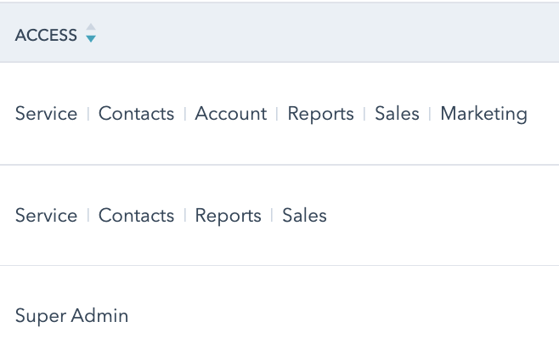
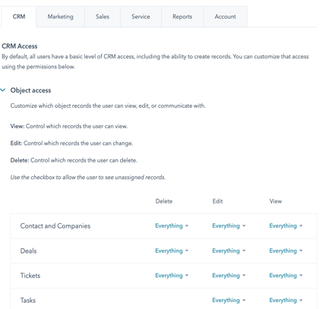
Product Subscription(s)
Access Level
Permission Level
Marketing Hub:
Free, Starter, Pro, Enterprise
Sales Hub:
Free, Starter, Pro, Enterprise
Services & Operations Hubs
Settings > Account Set Up > Users and Teams
Notes:
Example: Reports < Access to Reports (or not) < Permission

Slide 5
1
Workflows missing from top-level navigation
2
Empty contact lists
Prepare for surprises
3
Unable to export contact lists
4
Reports unavailable
5
No visibility into workflow enrollment

Slide 6
2. Personalization + segmentation

Slide 7
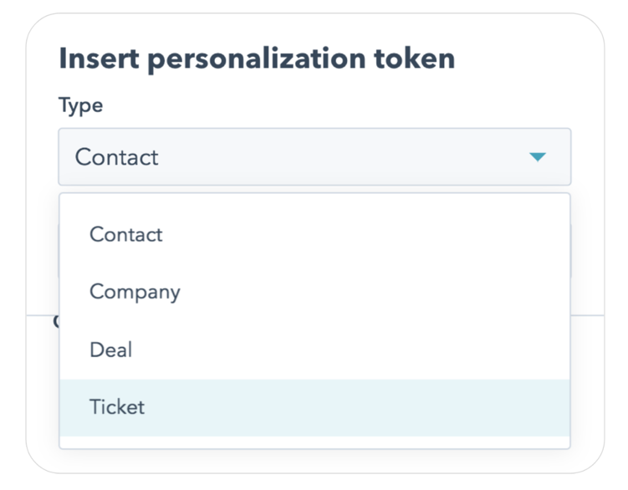
Go Beyond First Name
Notes:
You can insert personalization tokens for any properties related to Contact, Company, Deals, or Tickets (for Service Hub customers only)

Slide 8
1
Write out your dream list of marketing segments
Plan your future
2
Create new fields for segmenting
3
Change CRM fields (yes, you can!)
4
Bulk update existing records

Slide 9
Pro Tip
Painlessly dedupe
Contacts > Actions > Manage Duplicates
Critical if using LinkedIn Lead Gen Forms

Slide 10
3. Email strategy

Slide 11
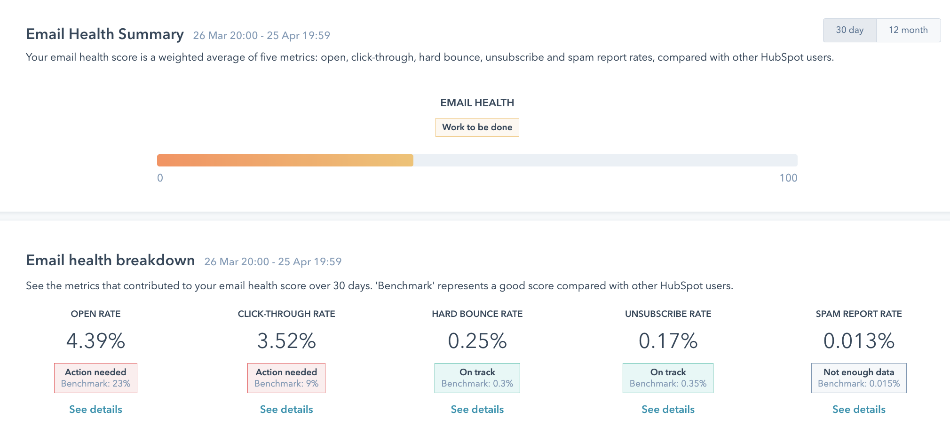
HubSpot is judgy AF
Notes:
Where to find this + more background

Slide 12
1
Give people options to raise their hands
Fight for what you want
2
Clean house
3
Nurture, nurture, nurture
4
Personalization and segmentation are not just nice-to-haves

Slide 13
Pro Tip
Save on marketing contacts
Only pay for contacts you email
Better yet, set up a workflow!

Slide 14
4. Workflows are your friend (really)

Slide 16
HubSpot Workflows vs. Sequences
Workflows
Sequences
Marketing Hub Pro or Enterprise
Subscription
Sales Hub Pro or Enterprise
Automate nurture emails
Automation
Automate nurture emails
Send marketing emails
Emails
Send sales emails
Automatic or manual triggers
Workflow Enrollment
Manual enrollment only
Stays in workflow until exit criteria met
Exit Criteria
Automatically exits sequence after reply
Replies not tracked in contact record
Tracking Replies
Replies tracked in contact record

Slide 17
1
Assign incoming leads to sales reps
2
Change lead status based on behavior
Put it on autopilot
3
Set lead score notifications
4
Assign follow up tasks (e.g., phone call)
5
Update fields (e.g., interest area)
6
Establish new customer welcome sequences

Slide 18
5. Demonstrate marketing ROI

Slide 19
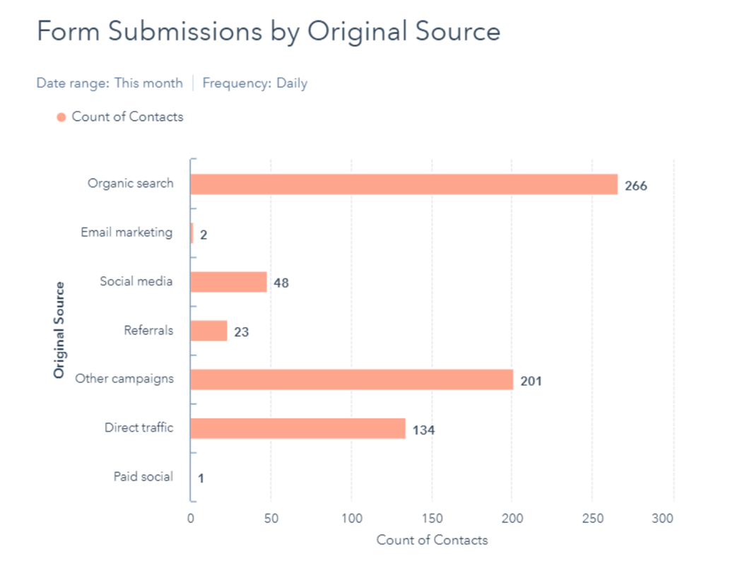

Slide 20
1
Report on leads
2
Monitor and measure touchpoints
Show your worth
3
Track conversions and deals
4
Align marketing and sales
5
Roll-up to see the impact

Slide 21
Make your relationship more love, less hate
HubSpot is customizable to a fault – make it work for you
Map out your journey
You’re not stuck
Everything is connected

Slide 22
Q&A
Melanie Hilliard
melanie@clarityqst.com
Twitter @social_melanie

